Slide 1

DATABASE FOR MINI-BLOG
HELLO I AM
SIRIUS
Qiaoyi He
Lu Ju
Naizhen Liu
Zitong Liu
Wanli Ma
Notes:
Hello everyone,
We are team Sirius. There are five people in my group, which are Wanli Ma, Naizhen Liu, Qiaoyi He, Zitong Liu and myself, Lu Ju. Today, I am going to introduce the mini-blog database system.

Slide 2

Index
Hello. I am Sirius.
3
2
Normalization & EER
Tables & Relations
4
1
User & Privilege
System Description
Notes:
The presentation has five sections, which elaborates the system in different aspects. General system description, tables and their relationships, normalization and our finalized EER Diagram, system ‘user’ and their privileges. The last part is the demonstration of our codes.

Slide 3


hiro
I already left you a comment.
baymax
I just posted a photo of us on mini-blog.
Mini-blog is an interactive platform. People can make friends, mention or talk to friends and strangers, follow and comment other users’ posts appear in one’s timeline, select one’s favorites list, insert graphical emoticons or attach own image and video files in every post.
Notes:
Mini-blog is an interactive platform, which is a hybrid of Twitter and Facebook. Once you become a registered user like hiro or baymax, you could post messages with photos or videos. Other registered users could post comments to your posting. Since the photo of hiro and baymax is so popular recently, once the photo’s comments exceed 5000 in a day, the photo will be posted on the hot topic page automatically. There is also a hashtag added to the photo named “Big Hero 6”. If other users search “Big Hero 6” in the searching field, this photo will pop out as well.

Slide 4

System Description
1
Part
ONE
Notes:
With mini-blog system, people could make friends in the virtual world and follow theirs trends. They may find people with same interests and hobbies as well.
Now I will explain the first part – system description.

Slide 5

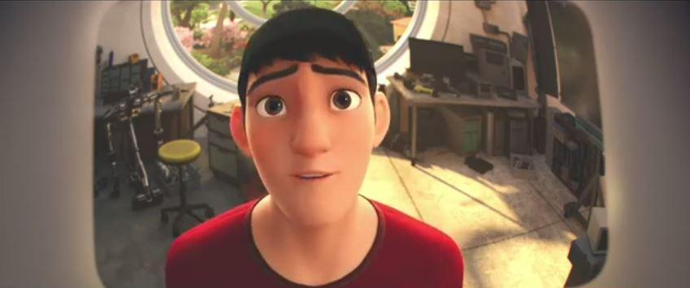



VIP Users
Authentic Users
Visitors
General Users
Browse Only
Basic Functions
VIP Privileges
Hold Activities
Friendly Links
Notes:
Members are divided into three types, general users, VIP users, and authentic users.
Visitor can only browse a few posts by authentic accounts. Neither general users nor VIP user accounts are accessible to visitors.
Once registered, you become a general user which could post ideas and interesting moments of your life, or whatever you want to share with others.
Registered user could pay to become a VIP user, which could enjoy the VIP privileges. VIP privileges includes block other users that you don’t want to share moments with, decorate their own pages, which you will have a different homepage other than default page.
Authentic users include celebrities, companies, and organizations. A “V” will be added to your photo. There will be a declaration on its homepage to show the verification. Once becoming an authentic user, you could hold activities online and offline. “SHOW YOUR FAVORITE MOVIES” is an online activity and “PICINIC in Boston common” is an offline activity. Additionally, authentic user could post link to other website which other users could not.

Slide 6
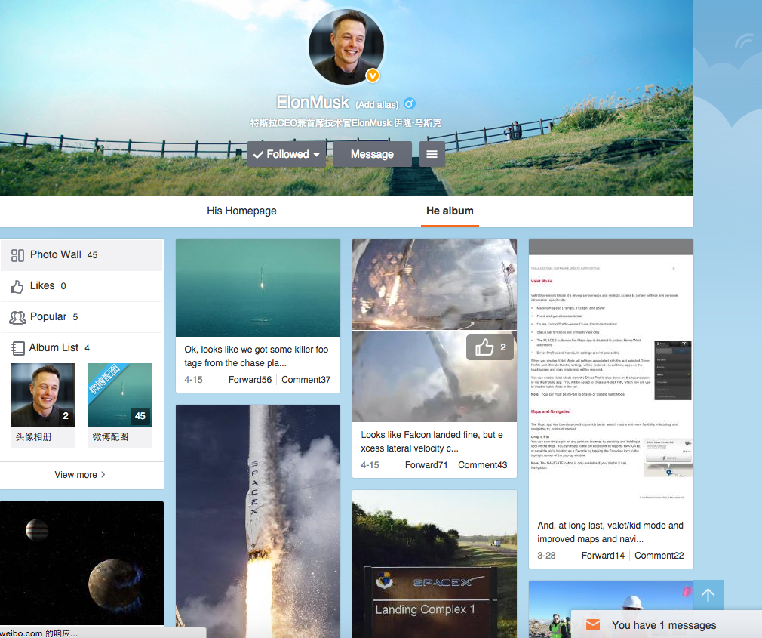

like
dislike
Notes:
An error page is something we don’t like to see. Developers responsible for any problems occurred in the system. They maintain the performance of mini-Blog. They will also develop new features for the system, which will make the system easy to use and have more fun exploring the system.

Slide 7

Mini-Blog
Interaction platform
Mini-Blog 2.0
More game functions will be added in the next generation.
Notes:
In the next generation of mini-Blog, we are going to add some mini games to the system.

Slide 8

Part
Tables & Relations
TWO
2
Notes:
Second part, tables and theirs relationships.

Slide 9
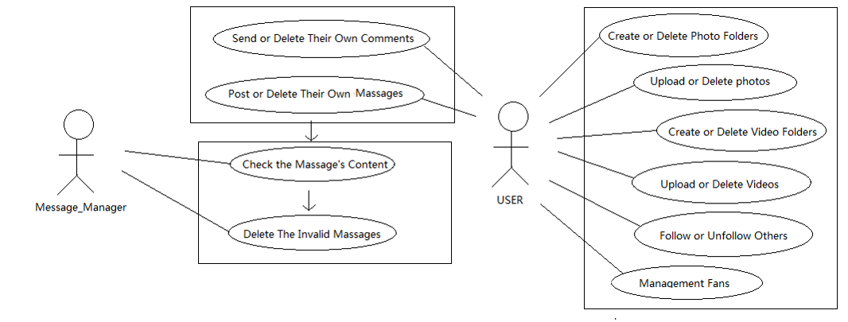
USE CASE

Slide 10
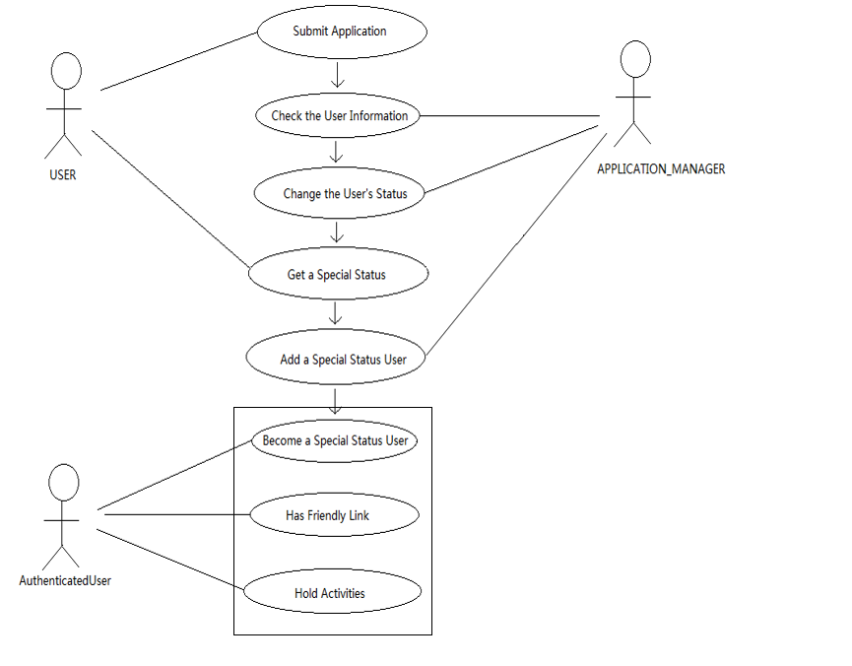
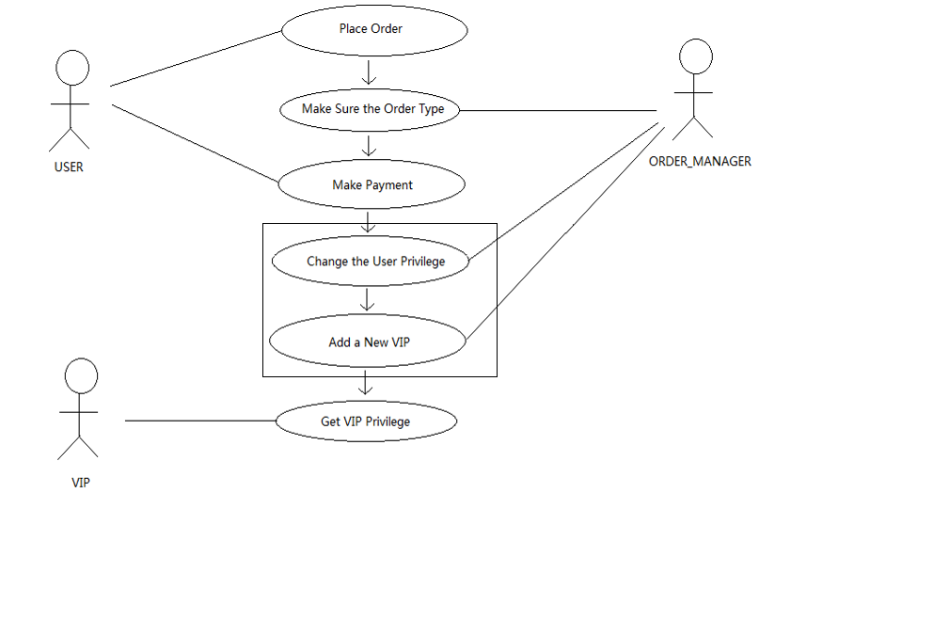
USE CASE
Notes:
I will explain use case briefly.
User submits application to be an authentic user, Application manager check the user information and change the user’s status.
User place an order to buy VIP privileges. Order manager make sure the order type and change the user privilege.

Slide 11
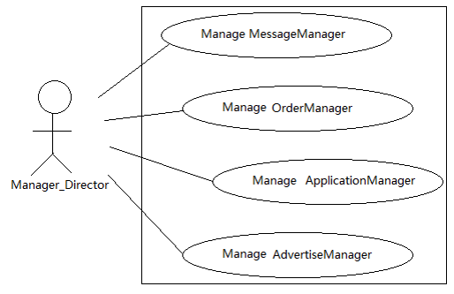
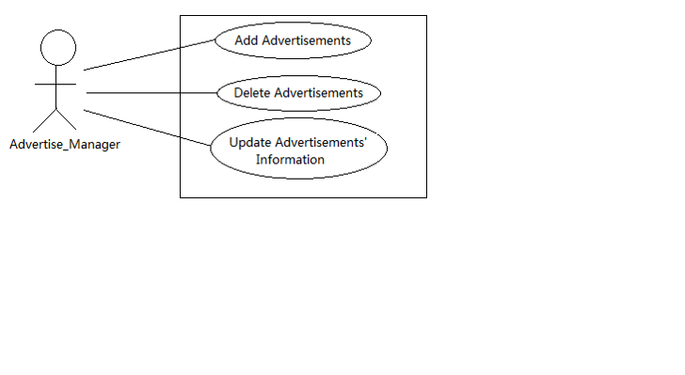
USE CASE

Slide 12
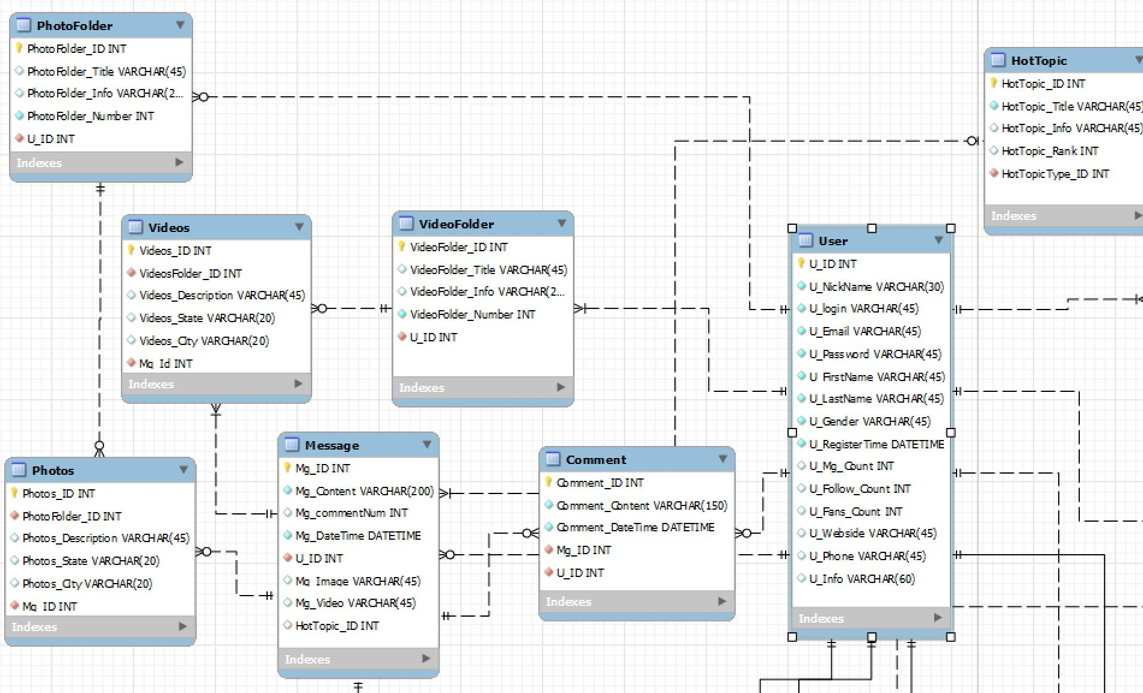
User Tables
Notes:
Next part explains tables related to user actions. User is the most important table in the system. One user could post zero or more messages. Text messages are stored in one table. Messages could include zero or one photo or video. Photos and videos are stored in separate tables. A set of photos or videos has the same folder name. One user could post zero or more comments. All comments are stored in the comments table. Hot topic will be stored in one table according to classification.

Slide 13
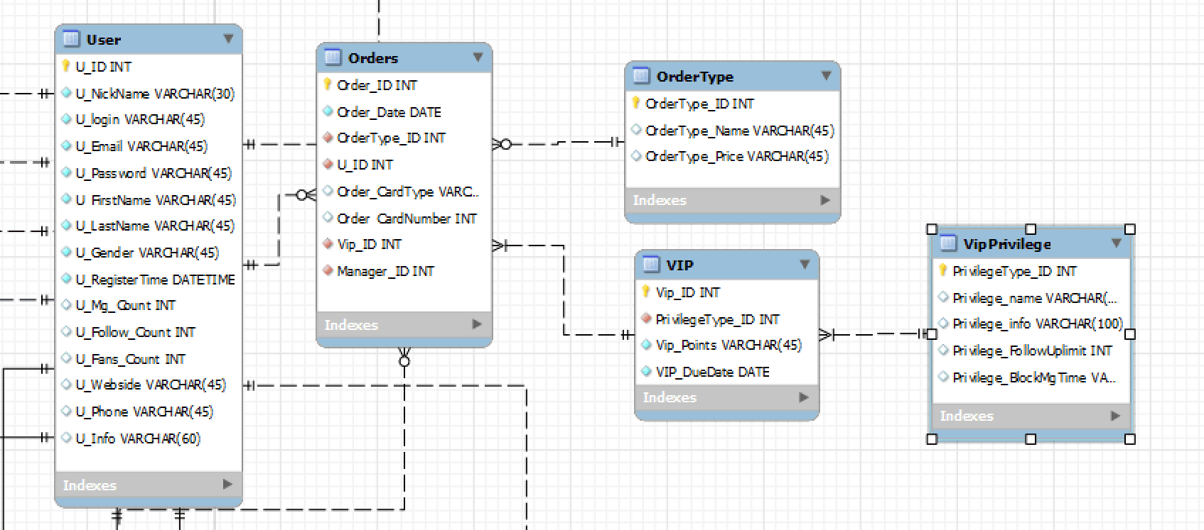
VIP Tables
Notes:
In order to be a VIP user, he could place order to buy VIP privileges. One user could put zero or more orders. One order contains one order type. For example, one-month VIP is an order type. Different order type has different price. In order form, user has to choose which kind of VIP he wants. Different VIP levels have different privileges.

Slide 14
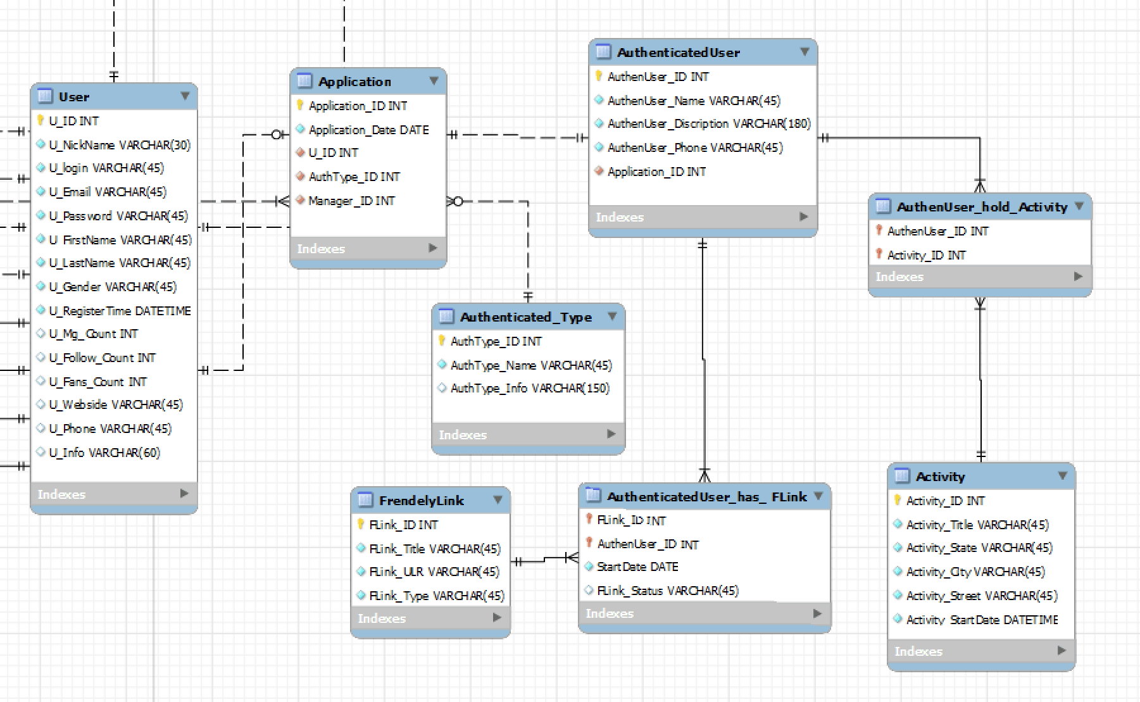
Authentic User Tables
Notes:
User submits applications to be authentic user. One user could only submit zero or one application. Authentic types include celebrity, organization and company. One authentic use could hold one or more activities. One authentic user could post one or more links.

Slide 15
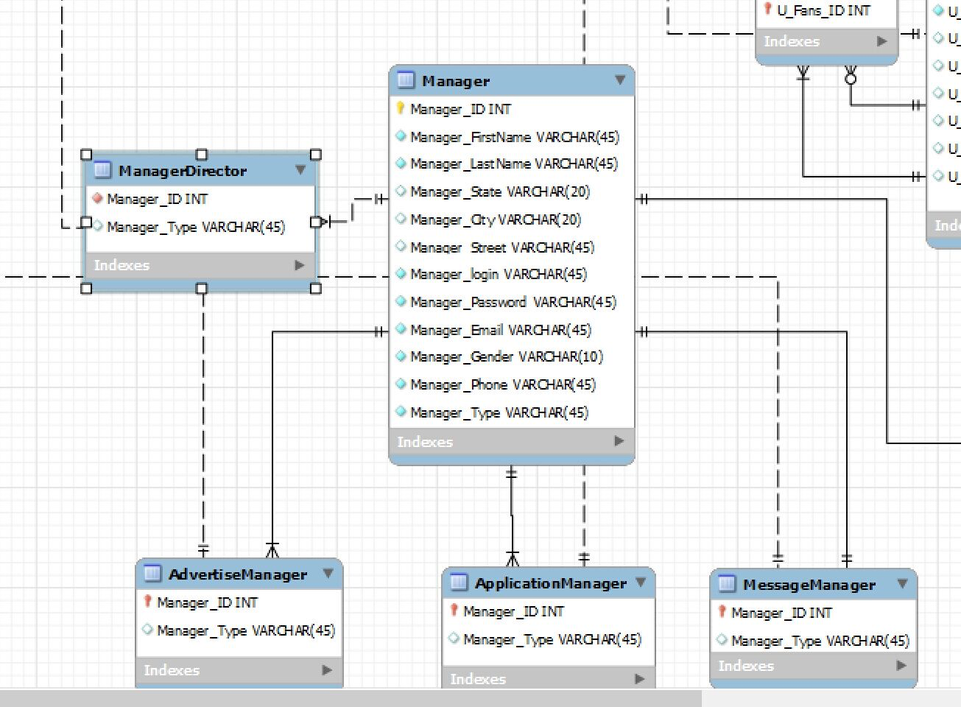
Manager Tables
Notes:
Manger is an import role in the system. Mangers are divided into five different types according to their fields. They are manager director, advertising manager, application manager, message manager and order manager. Manger director supervises other managers.

Slide 16

Part
THREE
3
Normalization & EER
Notes:
After deciding what kind of tables we have, we headed to the normalization part.
In this part, I will explain the normalization steps and our finalized EER Diagram.

Slide 17

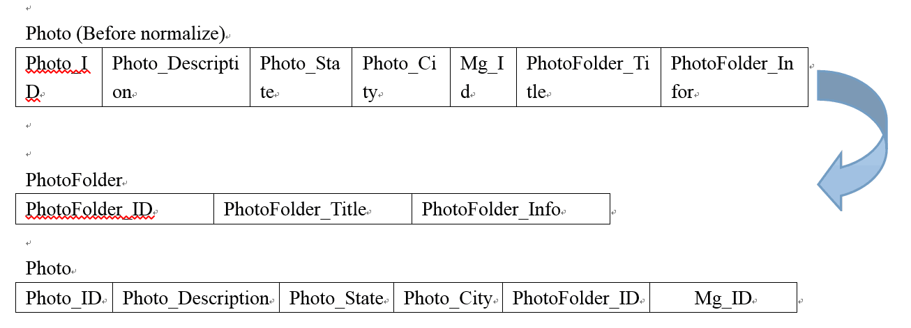
Mini-
Blog
Before normalization, photo table include 2NF.
Normalized into two different tables
Notes:
Everything related to photo was stored in one table. Then we found out that photo folder information depend on photo folder title. We normalized the table into two different tables, which are photo folder table and photo table. Photo folder includes photo folder id, photo folder title, photo folder information. Photo includes photo Id, photo description, photo state, photo city, photo folder id and message id.

Slide 18
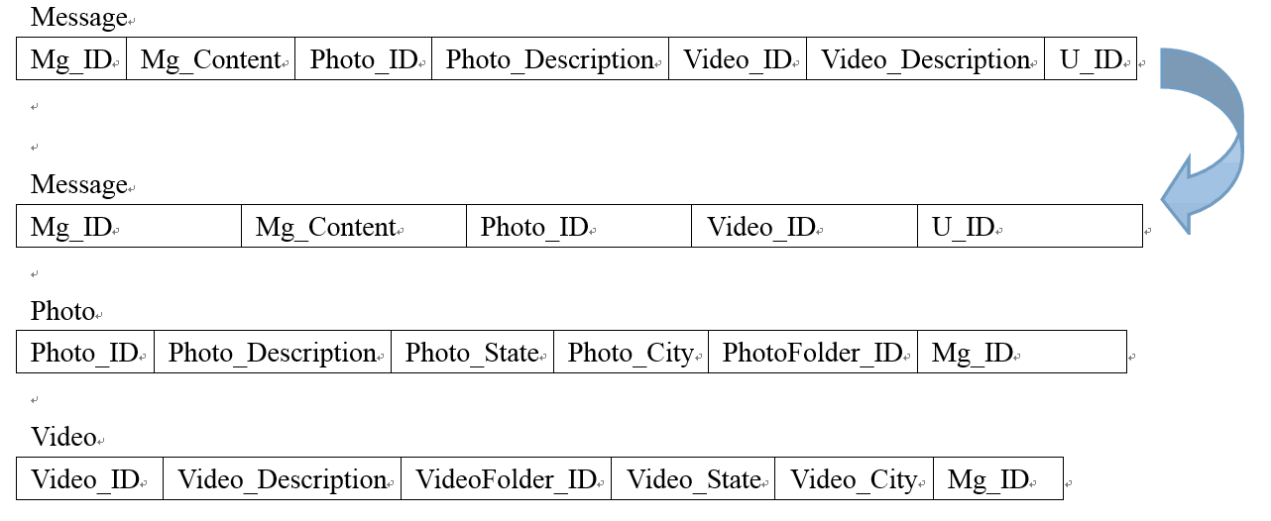
Mini-
Blog
Before normalization, photo table include 2NF.
After normalization, each table in 3NF.
Notes:
In message table, photo description and video description depend on photo id and video id respectively. We normalize the table into three different table, which are message table, photo table, video table. Each one is in 3NF.

Slide 19
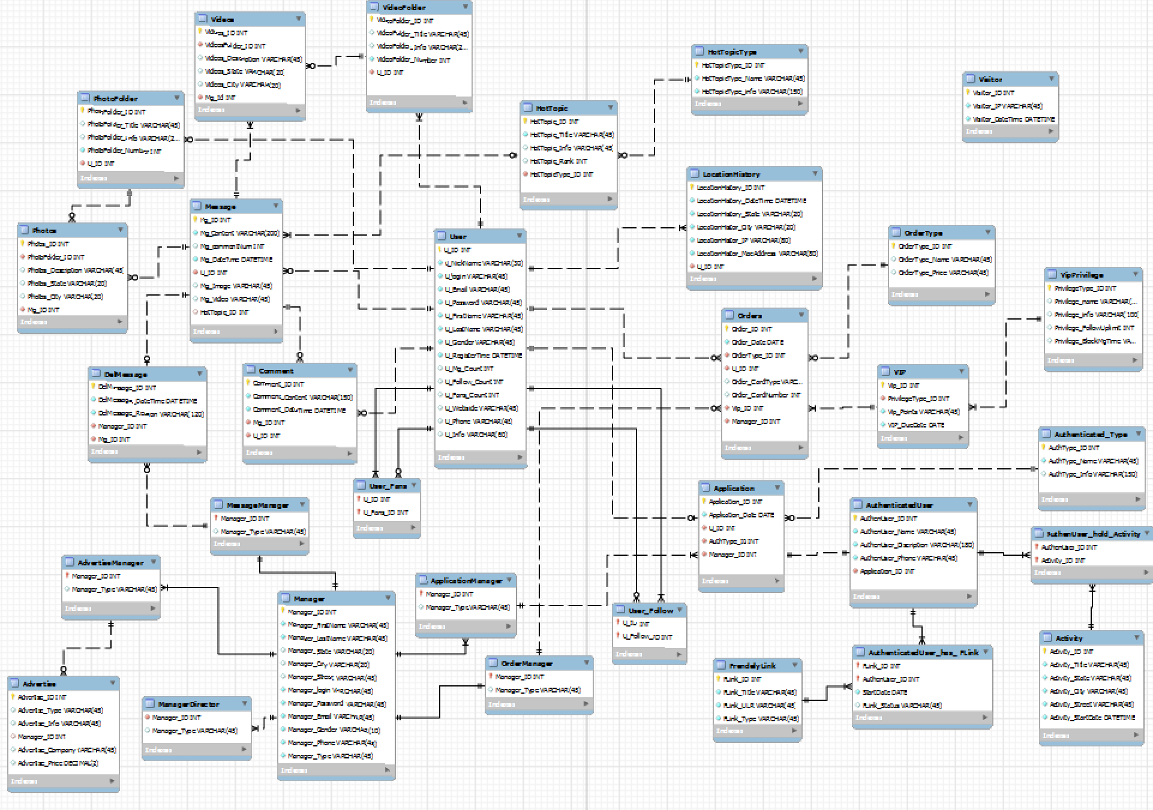
EER
Notes:
This is out finalized EER Diagram. All tables are in 3NF.

Slide 20
Part
User & Privilege
FOUR
4
Notes:
Part 4, system users and their privileges. In this part, I will talk about system users, which is different from the user I talked before.

Slide 21
USER :
Manager
Manager Director
All functions on manager table
Ad Manager
Select, insert, delete, update on advertise table
Application Manager
Select, insert, delete, update on application, authentic user table
Message Manager
All functions on message table
Order Manager
All functions on order, VIP table
Notes:
The first one is manager director. Manager director could perform all functions on manager table. Manager director has select function on advertise, activity, application, comments, friendly link, hot topic, photo folder, photo, video folder, video tables.
Advertisement manager could perform select, insert, delete, update on advertise table. Advertisement manager could perform select on all other tables.
Application manager could perform select, insert, delete, update on application, authentic user, and authentic type tables. Application manager has select function on all other tables.
Message manager could perform all functions on message table. Message manager has select function on all other tables.
Order manager could perform all functions on order table. Message manager could select on all other tables.

Slide 22
USER &PRIVILEGE
SELECT, DELETE, INSERT, UPDATE on authencateduser_has_flink, authenuser_holder_activity table
Select on specific tables
SELECT on order type table
General User
VIP User
Authentic User
Notes:
VIP USER could view on his own order type.
Authentic user could select, delete, insert, update on link and activity table

Slide 23
Backup
347,231
MESSAGES HERE
We will perform a full backup(FB) on Monday and Thursday every week. Incremental Backup(IB) on the other days of the week.

Slide 24
Security issues
Users who want to upgrade to VIP may be charged twice
Database association problem arises
Concurrency problem
Order security

Slide 25

CODE EXECUTION
I will always be with you.

Slide 26
THANK YOU
SIRIUS Present

